Slide 1

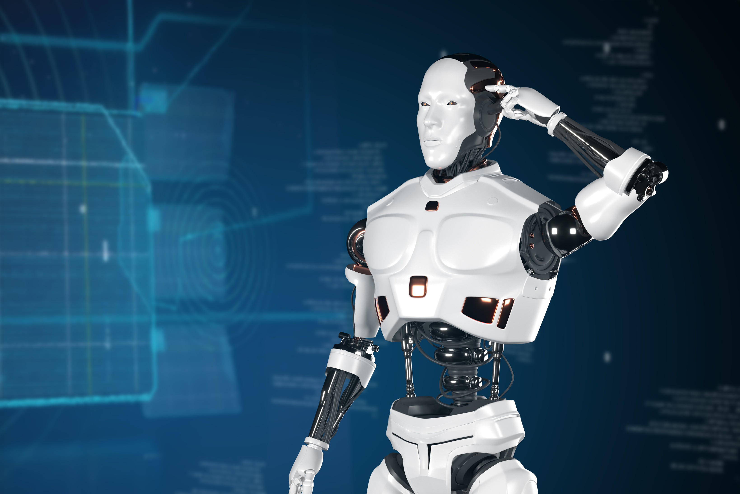

DESKTOP VIRTUAL
ASSISTANT
Submitted by:-
ANKIT KUMAR (20421510)
SHUBHAM KUMAR (20321517)
SUMIT KUMAR SINGH(20421529)
YASH RAJ (20421533)
SAMEER (20421533)
Exploring Cutting-Edge Technology Shaping The Future

Slide 2
INTRODUCTION
In the modern era, AI-powered voice assistants have become an integral part of our daily lives, simplifying tasks and enhancing user experience through natural language interactions. Desktop Virtual Assistant which is designed to simplify daily desktop operations and enhance productivity. This assistant combines powerful features like voice interaction for hands-free control, application and file management, multimedia tools such as screen recording and screenshots, and real-time utilities like language translation, currency conversion, and weather updates. Built using advanced technologies like Speech Recognition, OpenCV, and Google AI Generative Language, the assistant ensures accurate, real-time responses and seamless user interaction. Its goal is to bridge the gap between users and technology, offering a user-friendly, efficient, and intuitive system for all.

Slide 3

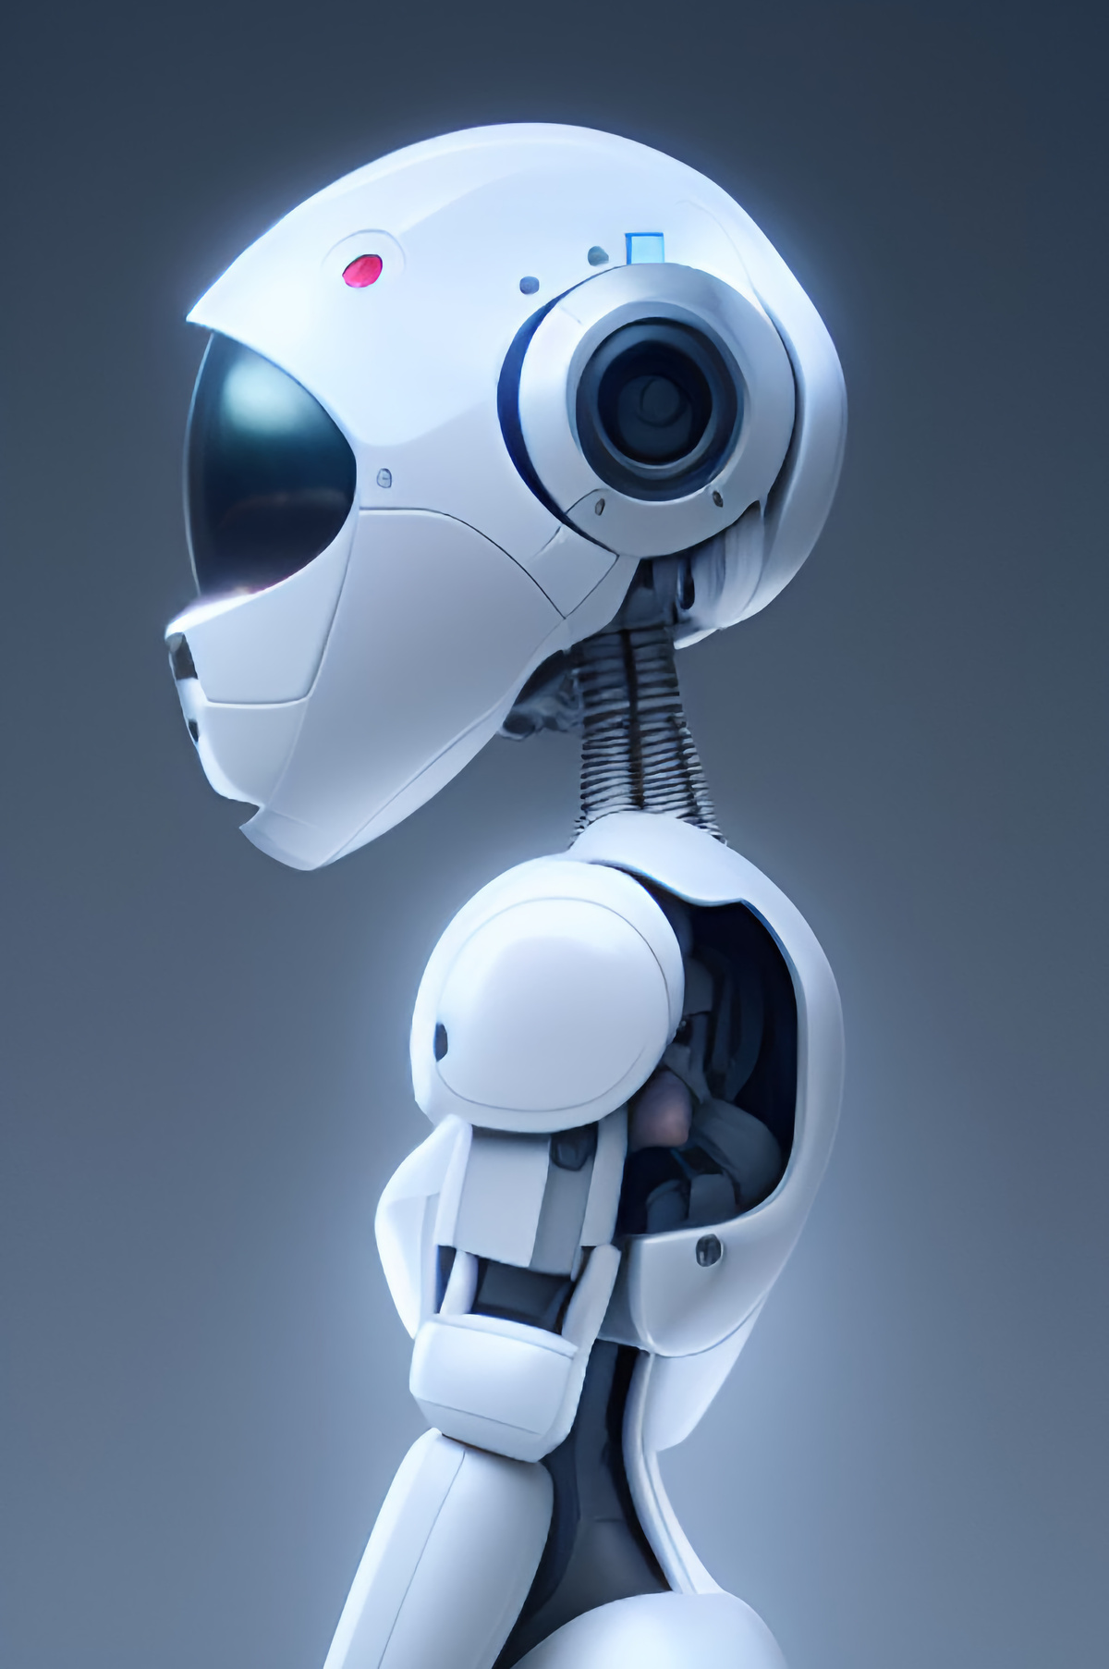
AIM
1.
Create an Intelligent and Responsive Desktop Virtual Assistant
2.
It can seamlessly integrate with various system functions and online services
3.
Create a robust and scalable system that bridges the gap between user needs and modern desktop automation

Slide 4

Develop a Versatile AI Voice Assistant:
Create an AI-powered assistant capable of understanding and executing a wide range of voice commands, providing a seamless user experience across multiple tasks.
2. Integrate Natural Language Processing:
Utilize Google Gemini language models to accurately interpret and respond to user queries in natural language, ensuring meaningful and contextually appropriate interactions.
3. Enable System and Application Control:
Implement functionalities that allow the assistant to open files, launch applications, and manage system operations through voice commands, enhancing user convenience.
4. Facilitate Web Browsing:
Incorporate the ability to open and navigate websites, enabling the assistant to access and present online information as requested by the user.
5. Ensure User-Friendly Interaction:
Design the assistant to be intuitive and easy to use, with a focus on enhancing productivity and simplifying complex tasks for users of all technical backgrounds.
6. Test and Optimize for Performance:
Continuously test and refine the assistant’s performance to ensure it operates efficiently, accurately, and with minimal latency.
OBJECTIVE

Slide 5

FUNCTIONAL
REQUIREMENTS
1. Open Applications:
Input: User provides a command specifying the application to open.
Output: The requested application is launched.
Description: The system should identify and execute user commands to open desktop applications quickly and efficiently.
2. Search for Files:
Input: User specifies file name or attributes such as type or date.
Output: The system locates and displays the specified file.
Description: The assistant should efficiently search and retrieve files using the given parameters, simplifying file management.

Slide 6
3. Capture Photo:
Input: User commands the assistant to capture a photo.
Output: The photo is taken and saved using the device's camera.
Description: The assistant should enable photo capturing by accessing the system's
camera, ensuring easy and quick operation.
4. Screen Capture and Recording:
Input: User requests a screenshot or screen recording.
Output: The assistant captures a screenshot or starts/stops recording the screen.
Description: The system should support on-demand screen capture and recording,
enabling users to create visual content with minimal effort.
5. Open Directories and Folders:
Input: User specifies a directory or folder to open.
Output: The specified directory or folder is opened.
Description: The assistant should provide quick access to directories and folders
based on user commands, ensuring smooth navigation.

Slide 7
6. Currency Converter:
Input: User specifies the amount and currencies for conversion.
Output: The converted amount is displayed based on current exchange rates.
Description: The system should perform accurate and real-time currency
conversions to assist users in financial tasks.
7. News and Weather Updates:
Input: User requests the latest news or weather forecast.
Output: Current news headlines or weather details are displayed.
Description: The assistant should fetch and present real-time news and weather
information to keep users informed.
8. Translate Language:
Input: User provides text or speech for translation.
Output: The text or speech is translated into the desired language.
Description: The system should provide multilingual translation to improve
communication and accessibility.

Slide 8
8. Translate Language:
Input: User provides text or speech for translation.
Output: The text or speech is translated into the desired language.
Description: The system should provide multilingual translation to improve
communication and accessibility.
9. Web Assistance:
Input: User requests a web search or specific online content.
Output: Relevant search results or online content are displayed.
Description: The assistant should perform internet searches and retrieve relevant
content efficiently
10. Voice Interaction
Input: User speaks commands or queries.
Output: The assistant processes the input and provides a response or executes the command.
Description: The system should integrate natural language processing to handle voice commands effectively for hands-free operation.

Slide 9
NON-FUNCTIONAL
REQUIREMENTS
1. Performance:
Response Time: Ensure low-latency response for real-time interactions.
2. Accuracy:
Voice Recognition: Maintain high accuracy in recognizing and processing
voice commands across various accents and dialects.
Task Execution: Ensure precise execution of user commands without errors or
misinterpretations.
3. Scalability:
User Base: Scale to accommodate a growing user base.
Feature Expansion: Allow for the addition of new features and enhancements

Slide 10
4. Usability:
Accessibility: Cater to users with varying technical proficiencies.
Intuitive Design: Design a user-friendly interface for easy navigation.
5. Reliability:
System Stability: Prevent unexpected crashes or disruptions.
Error Recovery: Implement quick error detection and recovery mechanisms.
6. Security:
Data Encryption: Employ encryption protocols to protect user data.
Secure Authentication: Implement secure authentication methods

Slide 11
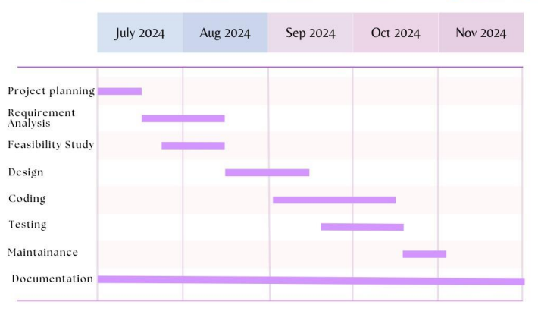
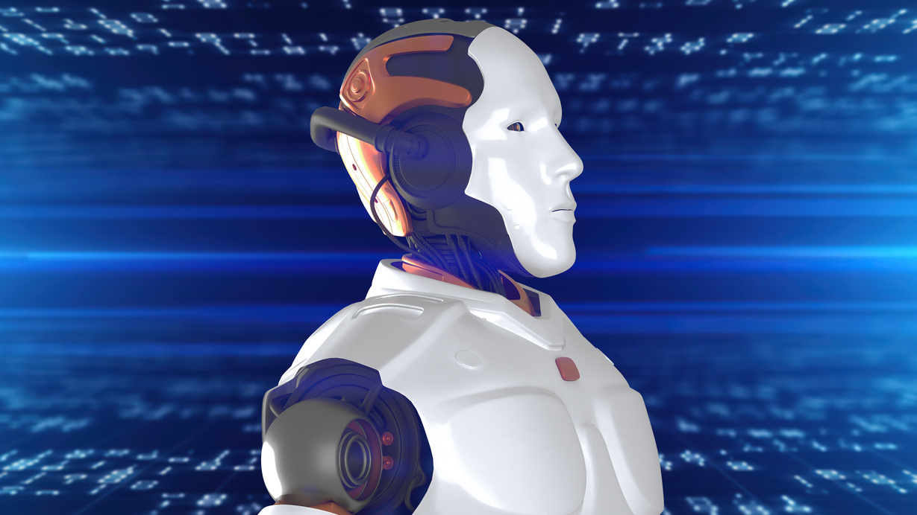
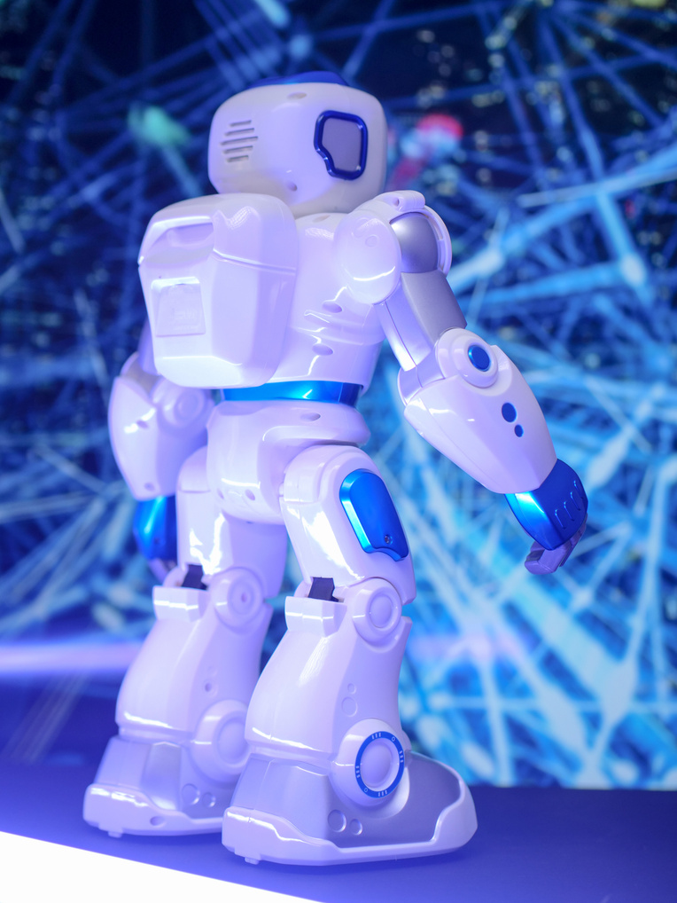
GANTT
CHART

Slide 12
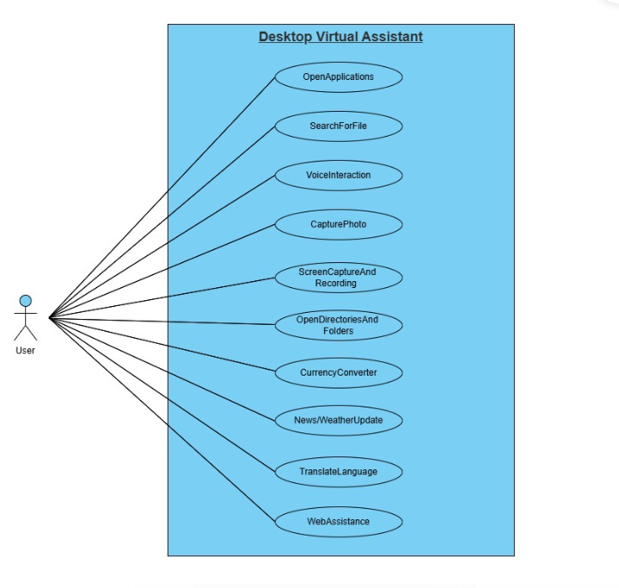
USE CASE
DIAGRAM

Slide 13
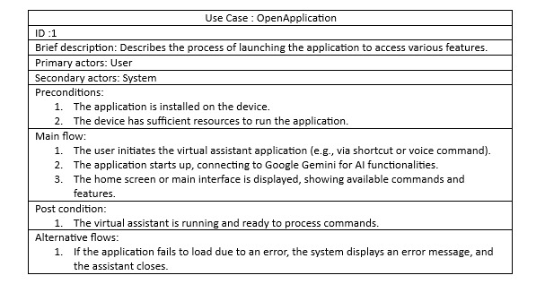
USE CASE
SPECIFICATION

Slide 14
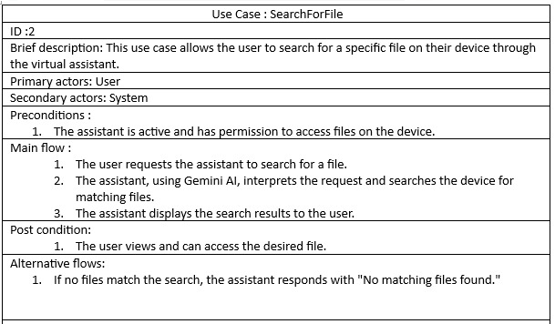
USE CASE
SPECIFICATION

Slide 15
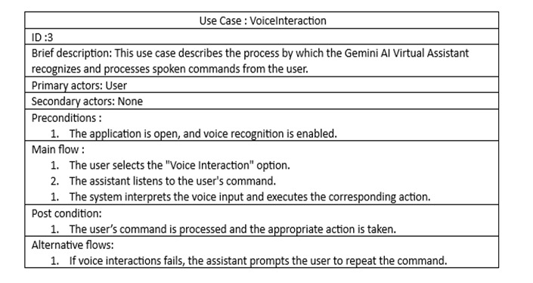
USE CASE
SPECIFICATION

Slide 16
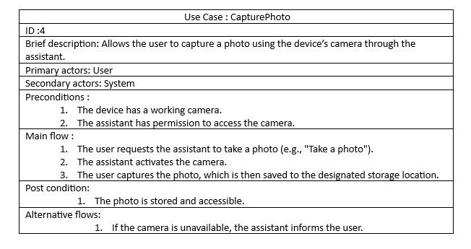
USE CASE
SPECIFICATION

Slide 17
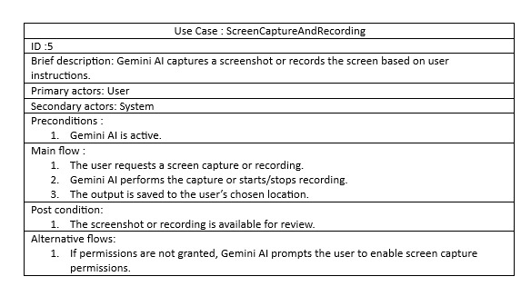
USE CASE
SPECIFICATION

Slide 18
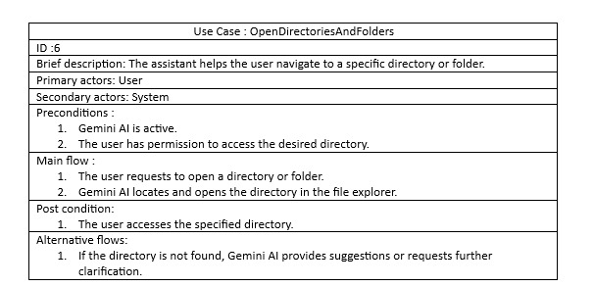
USE CASE
SPECIFICATION

Slide 19
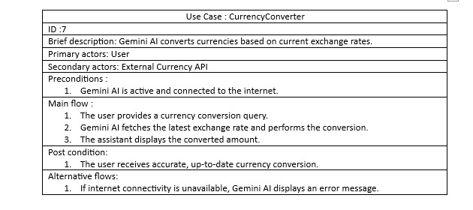
USE CASE
SPECIFICATION

Slide 20
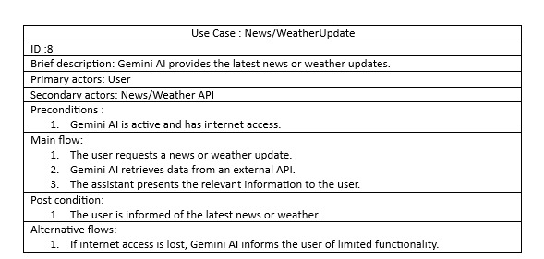
USE CASE
SPECIFICATION

Slide 21
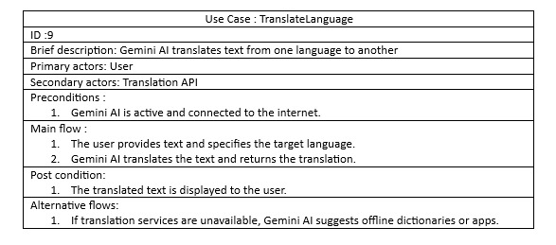
USE CASE
SPECIFICATION

Slide 22
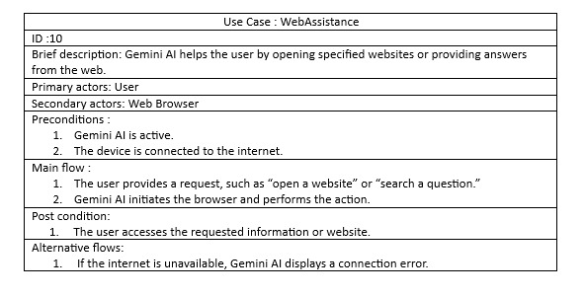
USE CASE
SPECIFICATION

Slide 23
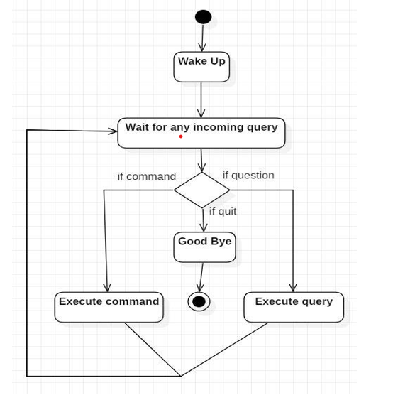
ACTIVITY
DIAGRAM

Slide 24
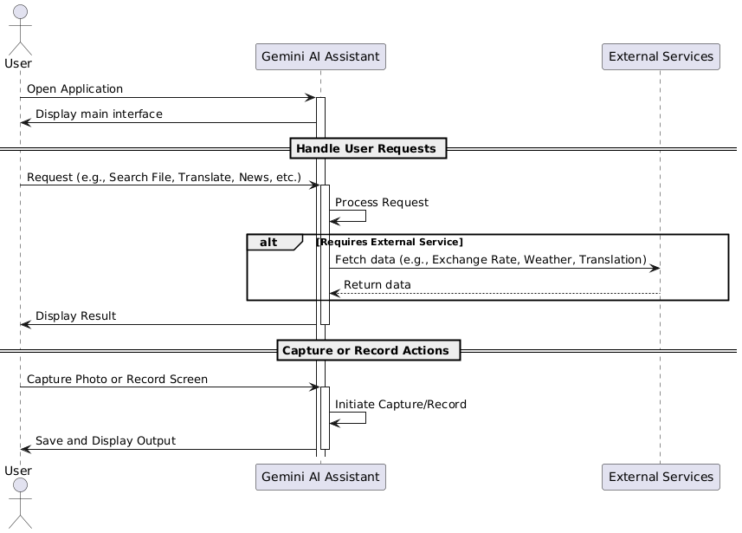
SEQUENCE
DIAGRAM

Slide 25
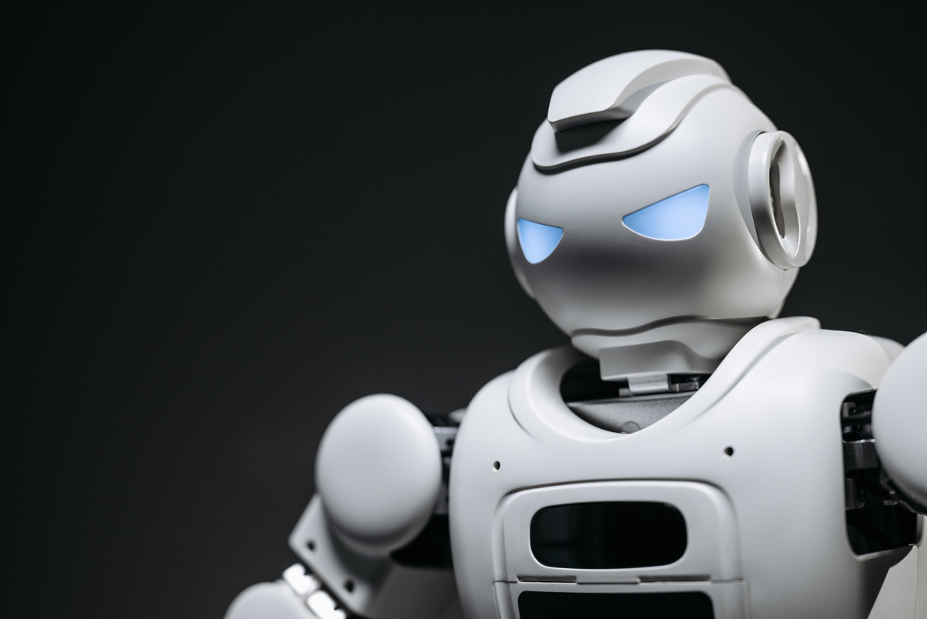
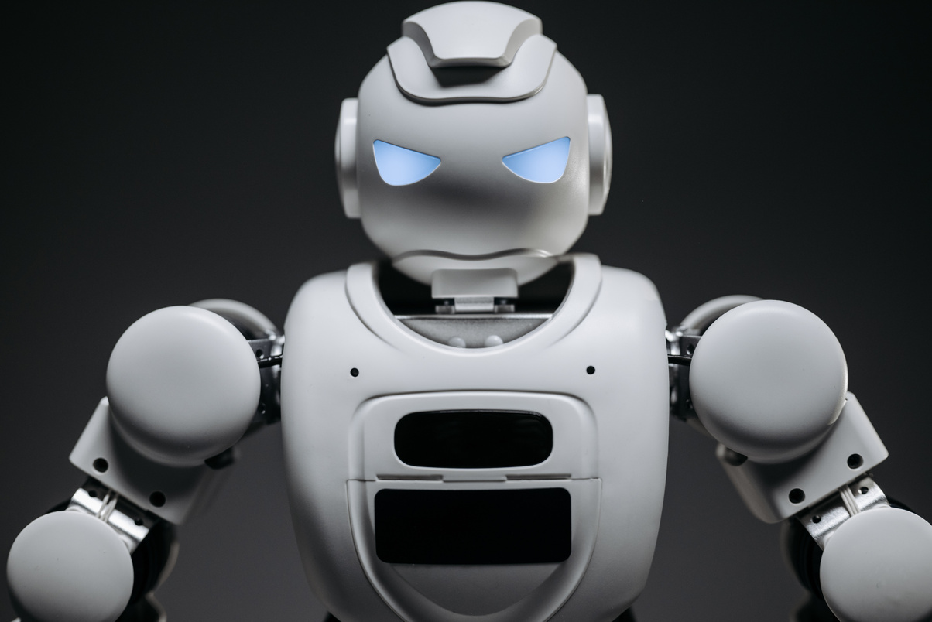
CONCLUSION
1. Bridges technology and user convenience by automating routine tasks.
2. Simplifies tasks such as application control, file management, language translation, and currency conversion.
3. Provides a streamlined and intuitive desktop experience.
4. Allows hands-free interaction through voice commands.
5. Enables quick and easy screen capture functionality.
6. Integrates with internet-based services to provide versatile features.
7. Designed to evolve with technological advancements and user needs.
8. Prioritizes a user-friendly, efficient, and accessible design.
9. Useful for both personal and professional tasks, aiming to be an indispensable tool for users.

Slide 26
FUTURE SCOPE
1. Integrate with Internet of Things (IoT) devices to enable seamless smart home control.
2. Expand its role in both personal and professional automation tasks.
3. Utilize advanced AI and machine learning to understand user behavior and provide personalized recommendations.
4. Enhance efficiency in executing complex tasks.
5. Integrate augmented and virtual reality (AR/VR) elements for immersive user interactions.
6. Increase compatibility across various devices like tablets, smartphones, and wearable technology.
7. Improve accessibility through collaboration with accessibility experts.
8. Add features for users with special needs, such as screen readers and adaptive input methods.

Slide 27
REFERENCES
1. Geeks for Geeks
https://www.geeksforgeeks.org/creating-a-virtual-assistant-in-python/Speech Recognition in Python
https://www.geeksforgeeks.org/speech-recognition-in-python-using-googlespeech-api/ty, usability, and reliability of every aspect of the assistant.
2. Python Official Documentation
https://docs.python.orghttps://numpy.org/doc/stable/
3. OpenCV Documentation
https://docs.opencv.org
4. Building GUI for Virtual Assistants
https://www.geeksforgeeks.org/building-a-virtual-assistant-gui-using-tkinter-inpython/
5. Google Gemini Official Website
gemini.google.com

Slide 28
THANK
YOU!
Thank you for exploring the potential of AI technology with us! Let’s shape the future together.

